Slide 1
Artificial Intelligence Kick-off
What The Hack

Slide 2
Artificial Intelligence
deep learning
machine learning
neural networks
search
probabilistic reasoning
etc.
vision
speech
language
knowledge
problem solving
etc.
A set of technologies that enable machine intelligence to simulate or augment elements of human thinking
Notes:
Thought I’d kick off with a quick introduction to k
Artificial intelligence is a set of technologies that enable ‘machine intelligence’ to simulate or augment elements of human thinking. For example, those technologies on the left, such as machine learning and neural networks. And those elements of human thinking on the right, such as vision, speech, and language.
There is a very subtle, but important, aspect in this definition. We are not advocating that machine intelligence should ‘replace’ human intelligence. But, machine intelligence can be used effectively to ‘augment’ or improve the human experience, accomplished via a set of more specialized use cases that map to individual elements of human thinking.
That, is where we think, that at least today, is the greatest opportunity for you as well.

Slide 3
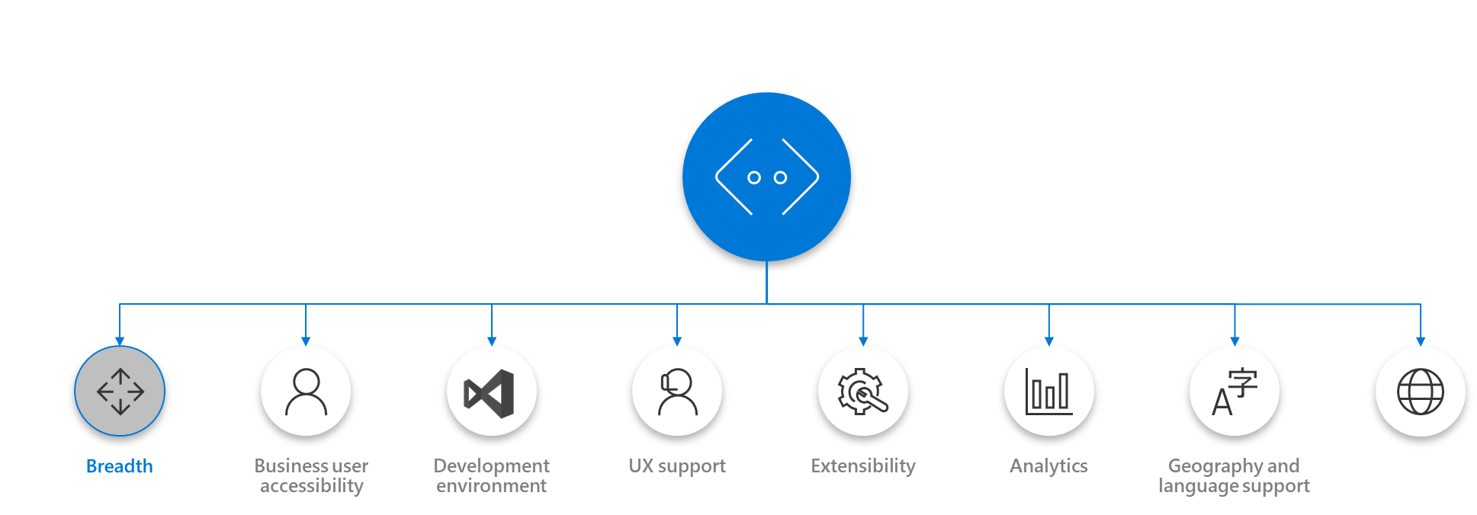
Microsoft AI Platform: Azure + AI
AI SERVICES
AI TOOLS
CONVERSATIONAL AI
AI MODULES
DEVICES
Azure Bot Service
Cognitive Services
Azure IoT Edge
CODING & MANAGEMENT TOOLS
VS Tools for Machine Learning
Azure ML Studio
Azure ML Workbench
AI INFRASTRUCTURE
Others (Pycharm, Jupyter notebooks…)
AI ON DATA
AI COMPUTE
DEEP LEARNING FRAMEWORKS
Cosmos DB
SQL
DB
SQL
DW
Data Lake
Spark
DSVM
Batch AI
ACS
Edge
Cognitive Toolkit
TensorFlow
Caffe
CPU, GPU, FPGA
Others (Scikit-learn, MXNet, Keras, Gluon…)
Notes:
Acronyms
ACS: Applied Computer Solutions
CPU: Central Processing Unit
DB: Database
DSVM: Data Science Virtual Machine
DW: Data Warehouse
FPGA: field-programmable gate array
GPU: Graphics Processing Unit
IOT: Internet of Things
ML: Machine Learning
VS: Visual Studio

Slide 4


MICROSOFT’S Conversational Computing Platforms
BOTS ARE GATEWAYS TO AI SERVICES
Breadth
Business user accessibility
Development environment
UX support
Extensibility
Analytics
Geography and language support
Compliance
Notes:
Notes about Cognitive Services (CS) evolution
Linguistic Analysis is currently in Free preview out of Azure. As we streamline our efforts on the features and services our customers value most, the Microsoft Cognitive Services Linguistic Analysis API will end on May 2018 (date to be confirmed), and we recommend using the Text capabilities of Azure Machine Learning going forward.
Web Language Model is currently in Paid preview on Azure. As we streamline our efforts on the features and services our customers value most, the Microsoft Cognitive Services Web Language Model will end on May 2018 (date to be confirmed), and we recommend using the Text capabilities of Azure Machine Learning going forward.
Emotion is in Paid preview on Azure. As Face API now integrates Emotion recognition, we’ll deprecate Emotion API for May 2018 (date to be confirmed), and we’ll recommend using Face API going forward.
Entity Linking is a service in Free preview out of Azure – in order to be consistent with Azure standards, we’re surfacing this service in the Cognitive Services Labs site. Going further, users will be able to try Entity Linking through the Cognitive Services labs portal.
Knowledge Exploration is a service in Free preview out of Azure – in order to be consistent with Azure standards, we’re surfacing this service in the Cognitive Services Labs site.
Academic Knowledge is a service in Paid preview on Azure. We’re surfacing now this service in the Cognitive Services Labs site.

Slide 5
Conversational AI tools
Language Understanding Intelligent Service
Azure Search
QnA Maker
Teach your apps to understand commands from your users
Integrate search into a conversational experience
Distill information into conversational, easy-to-navigate answers
Bing Speech API
Speaker Recognition API
Translator
Custom Speech Service
Convert speech to text and back again, and understand its intent
Give your app the ability to know who's talking
Easily perform speech and text translation
Fine-tune speech recognition for anyone, anywhere
Notes:
Speech APIs provide state-of-the-art algorithms to process spoken language powered by Bing. This also includes speech synthesis for a subset of languages supported by speech recognition. With these application programming interfaces (APIs) developers can easily include the ability to add speech driven actions into their applications. In certain cases, the APIs allow for real-time interaction with the user as well. Additional capabilities include voice recognition and speaker identification as well as providing partial transcription, meaning that for supported languages the developer can get partial results before the user has finished speaking.
Bing Speech API: Convert audio to text, understand intent, and convert text back to speech for natural responsiveness. Converts spoken audio to text. Synthesize Speech - Synthesize audio from Text.
Custom Speech Service: Custom Speech Service (CRIS) enables you to create customized language models and acoustic models tailored to your application and your users. By uploading speech and/or text data to CRIS that reflects your application and your users, you can create custom models that can be used in conjunction with Microsoft’s existing state-of-the-art speech models. To customize the acoustic model to a particular domain, a collection of speech data is required. This collection consists of a set of audio files of speech data, and a text file of transcriptions of each audio file. The audio data should be representative of the scenario in which you would like to use the recognizer. If you were building an app to search Microsoft Developer Network by voice, it’s likely that terms like “object-oriented” or “namespace” or “dot net” will appear more frequently than in typical voice applications. Customizing the language model will enable the system to learn this. CRIS uses acoustic or language model adaptation to enable the speech recognizer to learn the characteristics of the customer’s data while still getting the benefits of all the data and expertise that went into creating the base models that power the Speech API.
For acoustic model adaptation, the technology is described in this paper: http://research.microsoft.com/pubs/194346/0007893.pdf
Works well when the data is uploaded to CRIS is truly representative of the user population and the expected usage of the application. For language model adaptation, it works best when the data uploaded reflects what people would actually say. Uploading simply a list of new terms is better than nothing but will not be as effective. For acoustic model adaptation, if you want to adapt to elderly speech, you need to upload the speech from many different elderly users, not just one or two. If you upload just one person’s voice, CRIS will learn to do a great job on that voice but will not necessarily learn to generalize to other elderly voices. Similarly, if you want to adapt to a new environment, like a factory, you should upload speech data from many speakers in the factory, not just one.
Speaker Recognition API: Microsoft's state-of-the-art cloud-based speaker recognition algorithms can recognize a human's voice in audio streams. It comprises of two components: speaker verification and speaker identification. Speaker Verification can automatically verify and authenticate users from their voice or speech. It is tightly related to authentication scenarios and is often associated with a pass phrase. Hence, we opt for text-dependent approach, which means speakers need to choose a specific pass phrase to use during both enrollment and verification phases. Speaker Identification can automatically identify the person speaking in an audio file given a group of prospective speakers. The input audio is paired against the provided group of speakers, and in case there is a match found, the speaker’s identity is returned. It is text-independent, which means that there are no restrictions on what the speaker says during the enrollment and recognition phases. A use case is biometric authentication using voice.

Slide 6
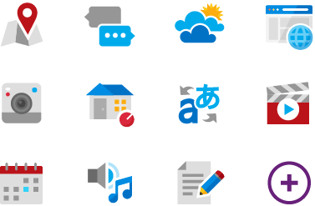



Language Understanding (LUIS)
Machine learning-based service to build natural language into apps, bots, and IoT devices. Quickly create enterprise-ready, custom models that continuously improve
Add natural language to your apps
Quickly build a custom language solution
Always learning and improving
Enterprise-ready, available worldwide
Designed to identify valuable information in conversations, LUIS interprets user goals (intents) and distills valuable information from sentences (entities), for a high quality, nuanced language model.
Custom Models can be created based on the same technology in Azure Machine Learning.
Leverages customizable pre-built apps and entity dictionaries, (e.g., Calendar, Music, Devices).
Dictionaries are mined from the collective knowledge of the web and supply billions of entries, helping your model to correctly identify valuable information from user conversations.
LUIS integrates seamlessly with the Azure Bot Service, making it easy to create a sophisticated bot.
Active learning is used to continuously improve the quality of the natural language models.
Once the model starts processing input, LUIS begins active learning, allowing you to constantly update and improve the model.
The service is ready to be deployed in commercial applications and can scale with enterprise quality and performance.
The service meets international compliance standards, supports 13 languages and available worldwide, making it highly accessible around the world.

Slide 7
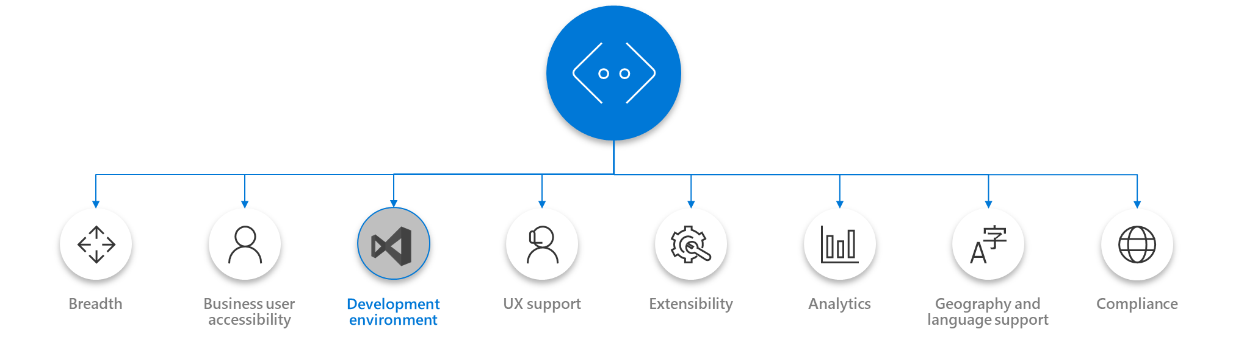
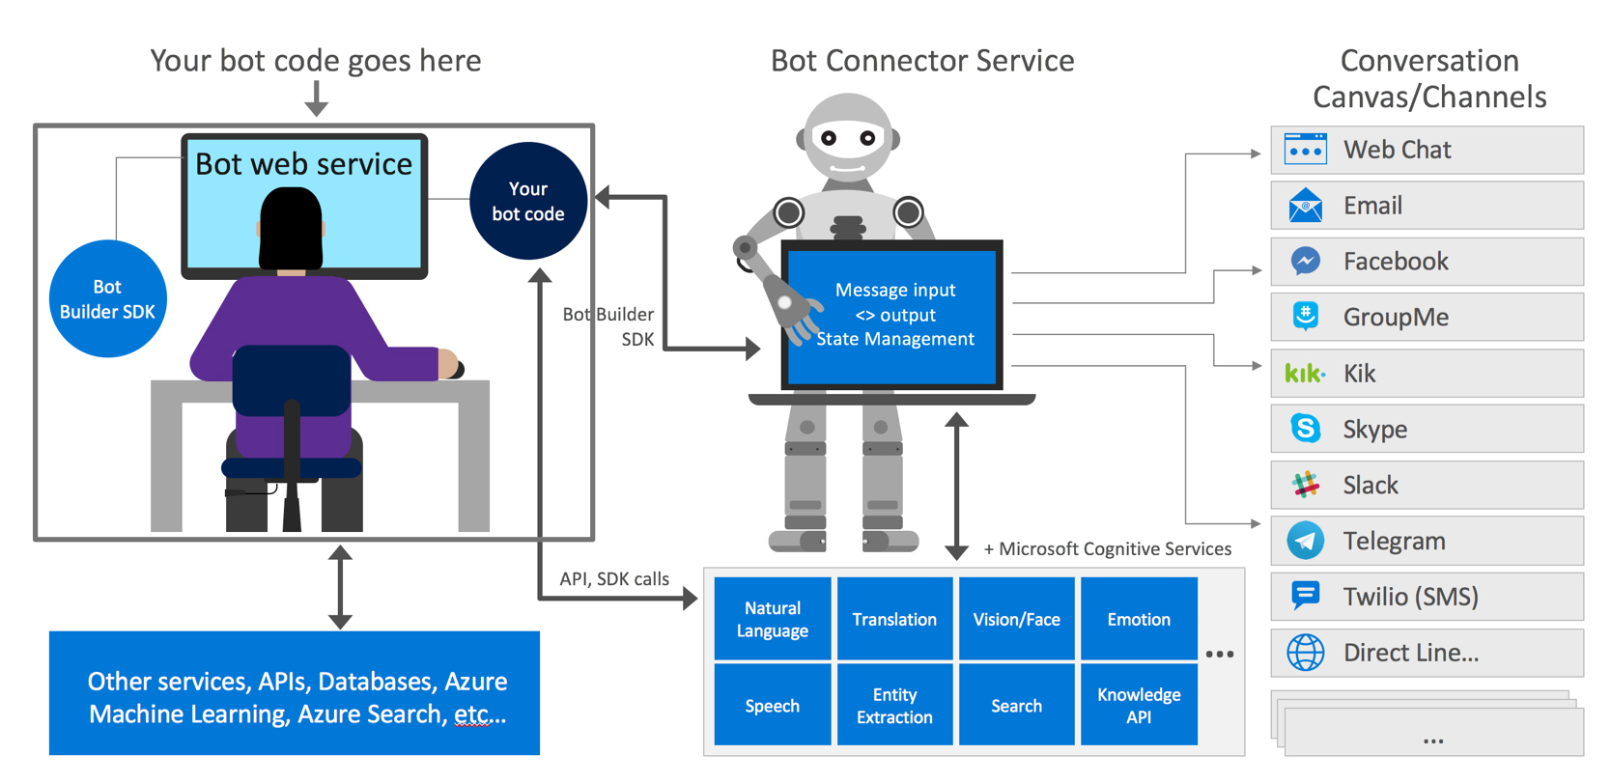
Microsoft Bot Framework
Development Environment
Notes:
https://docs.microsoft.com/en-us/bot-framework/overview-how-bot-framework-works

Slide 8


Microsoft Cognitive Services
Give your apps a human side
Vision
Speech
Language
Knowledge
Search
Computer Vision
Content Moderator
Emotion
Face
Video Indexer
Speech Service
Bing Speech
Speaker Recognition
Translator Speech
Bing Spell Check
Linguistic Analysis
Text Analytics
Translator Text & Speech
Web Language Model
Academic Knowledge
Entity Linking
Knowledge Exploration
QnA Maker
Bing Autosuggest
Bing Image Search
Bing News Search
Bing Video Search
Bing Web Search
Bing Entity Search
CUSTOMIZATION
CUSTOMIZATION
Custom Vision Service
Custom Speech Service
Language Understanding
Custom Decision Service
Bing Custom Search
Notes:
Roughly 30 services and growing
Collection of Intelligent APIs built through Years of research
No Infrastructure requirements
Target any type of application
Pre-built, but also 5 custom services
Today we will fous on the first one – vision.

Slide 9


What Computer Vision Can Do
Image Classification
Is there a deer in the image?
Image segmentation
Where exactly is the deer?
Image Similarity
Which images are similar to the query image?
Object detection
Where in the image is the deer?
Yes
Query image
Similar image
Notes:
For today, I thought we’d focus on computer vision – this is what was used in the Liebherr example.

Slide 10
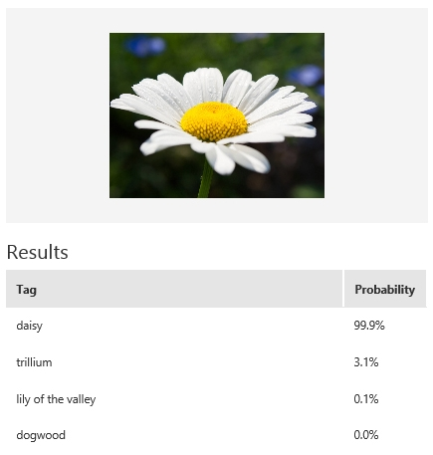
Custom Vision Service
Customizable web service that learns to recognize specific content in imagery
Upload Images
Upload your own labeled images, or use Custom Vision Service to tag any unlabeled images
Train
Use your labeled images to teach Custom Vision Service the concepts you want it to learn
Evaluate
Tag new images with your custom computer vision model and evaluate how well they are identified
Active learning
Images evaluated through your custom vision model become part of a feedback loop you can use to keep improving your classifier
Notes:
Custom Vision Service allows you to add your own images so you can go above and beyond the computer vision service.
Basics
Upload, Train, Evaluate, Active Learning
Example -> Flowers
Classifier only needs 30 images to start quick prototype

Slide 11





Custom Vision – IoT Edge Deployment
Custom Vision Docker Container
Processing Code Docker Container
Custom Vision Docker Container
Azure Container Registry
Processing Code Docker Container
Deployment Manifest
Deployment Manifest
IoT Edge Device
Azure IoT Hub
Custom Vision
Custom Code
Notes:
How to use them
Web API example
Any Platform, Any Language
Easy integration
MSFT products

Slide 12














How you can use Cognitive Services
AI-as-a-service
REST-based APIs in the cloud
Deploy as Docker Container to Edge (Vision)
Integrate into the language and platform of your choice
Bring your own data for a custom experience
Tap into an ever-growing collection of AI algorithms developed by experts in their field from Microsoft Research, Bing, and Azure Machine Learning
These capabilities are used across many Microsoft first party products such as Cortana, Bing and Skype
GET A KEY
BUILD
Ruby
Notes:
How to use them
Web API example
Edge example
Any Platform, Any Language
Easy integration
MSFT products

Slide 13
So many use cases!
Anomaly Detection
Fraud Detection
Yield Analysis
Root Cause Analysis
Predictive Maintenance
Video Surveillance
Crowd Management
Traffic Detection
Customer Satisfaction
Compliance
Precision Agriculture
Notes:
Predictive Maintenance
Default Detection
Fraud Detection (energy meters)
Video Surveillance
Connected Events
Crowd Movement (cell phones at Changi, Sports Arenas)
Intelligent Kiosk (?)
SmartSpaces
Customer Satisfaction (manage your own energy consumption relative to neighborhood)
Organizing/Tagging Data (e.g. what data needs to be saved for compliance)
Precision Agriculture (soil, insects, moisture measurements to determine how much fertilizer to apply)

Slide 14
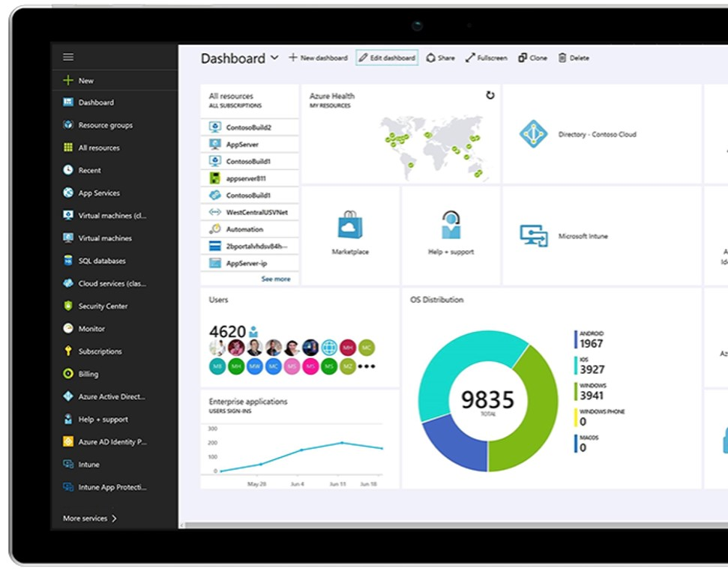
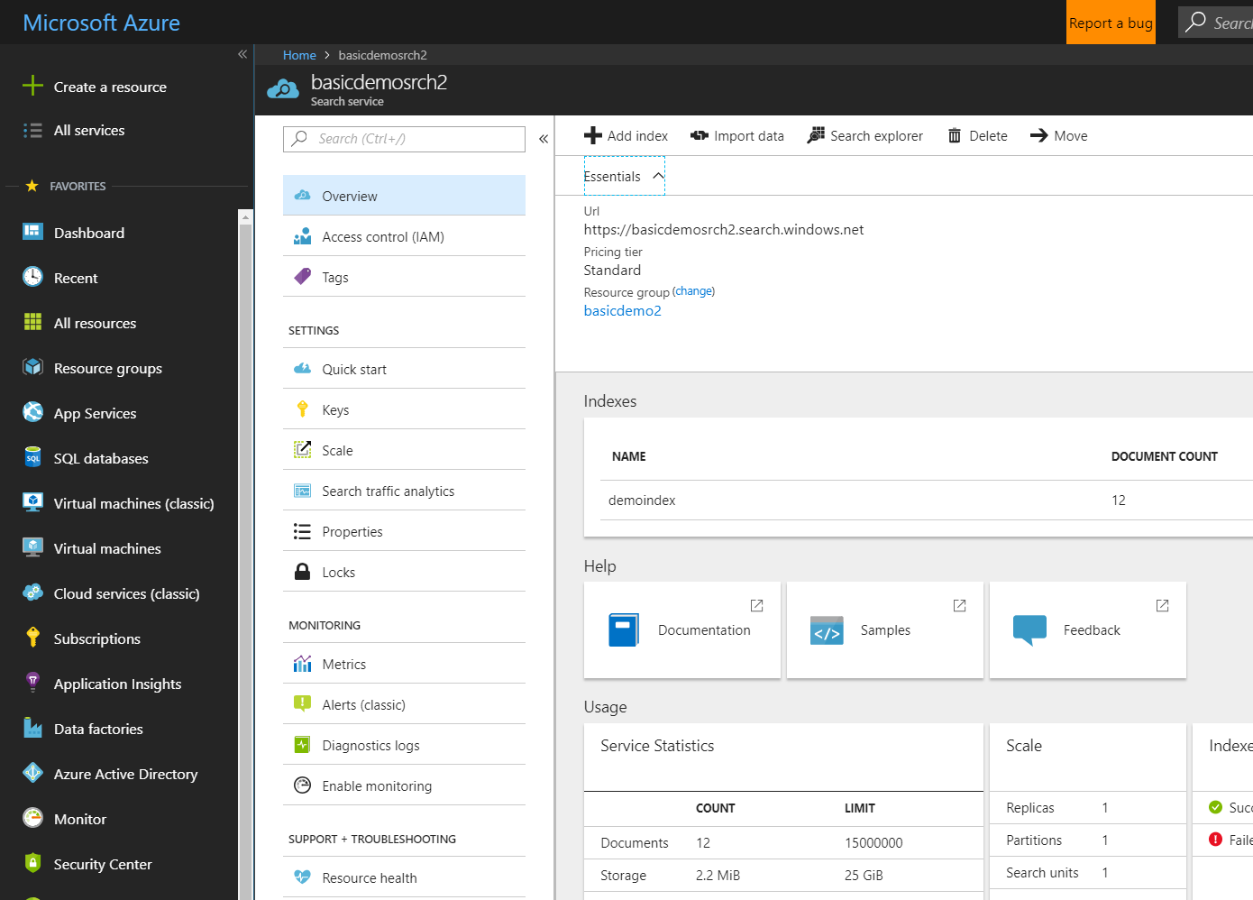

Azure Search Search-as-a-Service Management Free Keyword search Faceting Geospatial support Multi-Language Support Suggestions/auto-complete Customizable scoring models Proximity Search Synonyms etc.
Azure Search

Slide 15
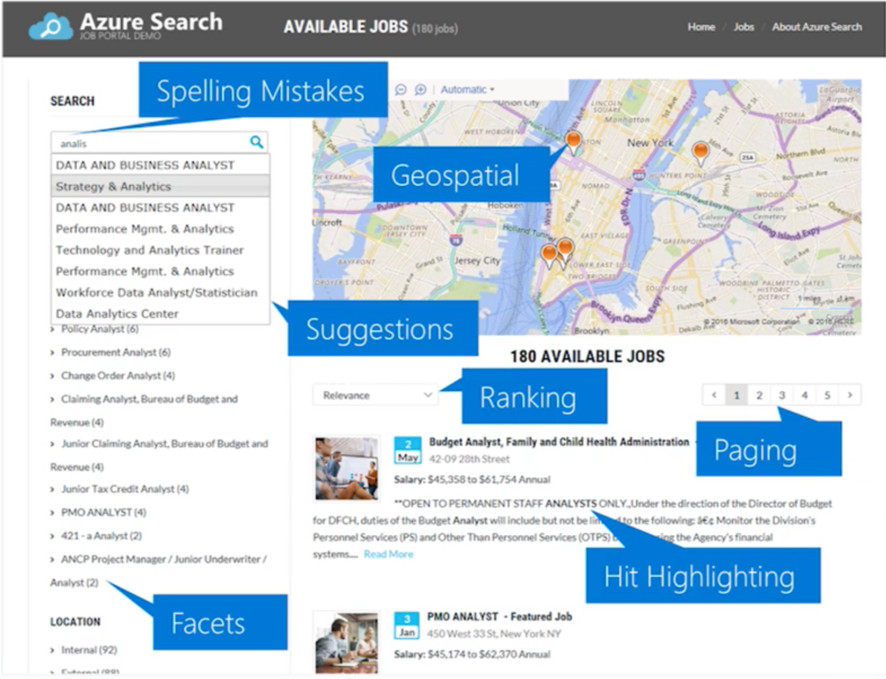

Slide 16
Cognitive Search
AN AI–FIRST APPROACH TO CONTENT UNDERSTANDING
Ingest
Enrich
Explore
Data
Cognitive Skills
Azure Search

Slide 17



Cognitive Search Architecture
IEnricher
IEnricher
Cognitive Skill
Document Cracking
Skillset:
Extensible enrichment
pipeline
Indexing for Search
Customer Data
Annotated Documents
Search Index
.pdf
.doc
.jpeg
…
Built-in Cognitive Skills OCR, Key Phrase Extraction, People Names, Company Names,
Sentiment Analyzer, Computer Vision,
etc.
Third Party Enrichers Custom classification models, Custom entity extraction,
etc.
Azure Machine Learning

Slide 18
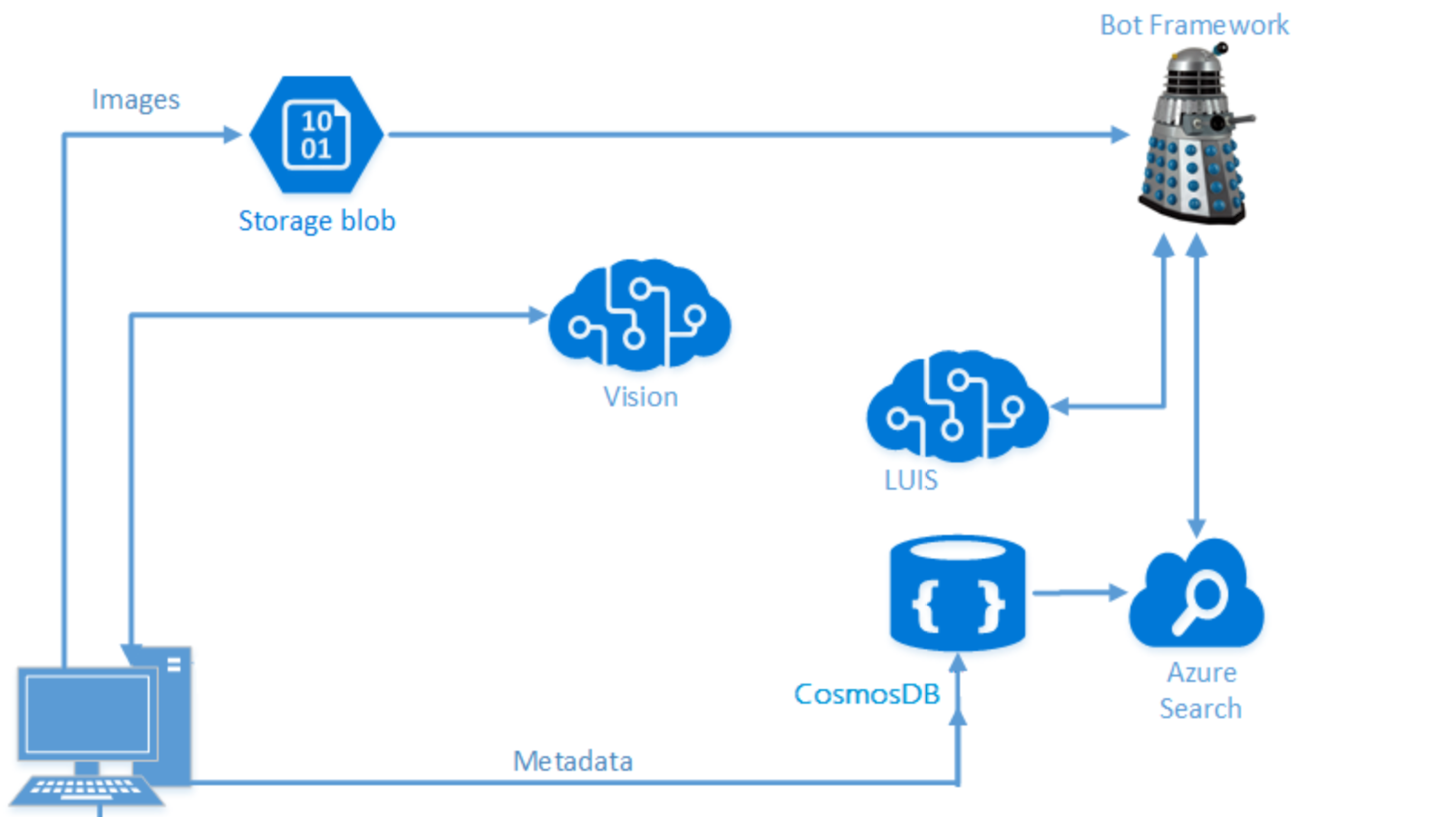
Ready to Start Hacking?
Your challenges are broken into two parts:
Cognitive Services
Bots

Slide 19
Part 1: Cognitive Services
Challenges
1.1: Create a Cognitive Services App using Portable Class Libraries
1.2: Create an Image Classification Application using the Custom Vision Service – Trees
1.3: Create an Image Classification Application using the Custom Vision Service – Vehicle Damage
1.4: Create an Image Classification Application using the Custom Vision Service – Bikes
1.5: Develop Intelligent Applications with Language Understanding (LUIS)

Slide 20
Part 2: Bots
Challenges:
2.1: Developing Intelligent Applications with Azure Search
2.2: Building Intelligent Bots
2.3: Log Chat Conversations in your Bot
2.4: Testing your Bot

